Slide 1
ECOBIKE RENTAL
Group 04

Slide 2
Member contributions
Trịnh Long: 30%
Nguyễn Thanh Tùng: 30%
Nguyễn Tuấn Anh: 20%
Ngô Quang Minh: 20%

Slide 3
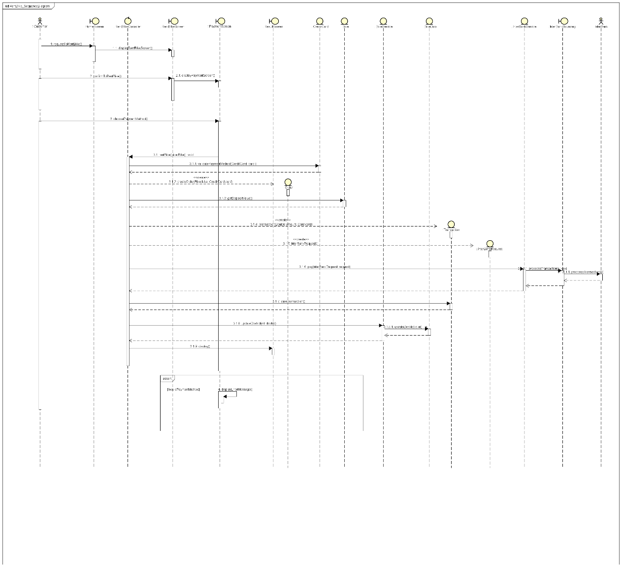
Interaction Diagram
Rent bike Sequence Diagram

Slide 4
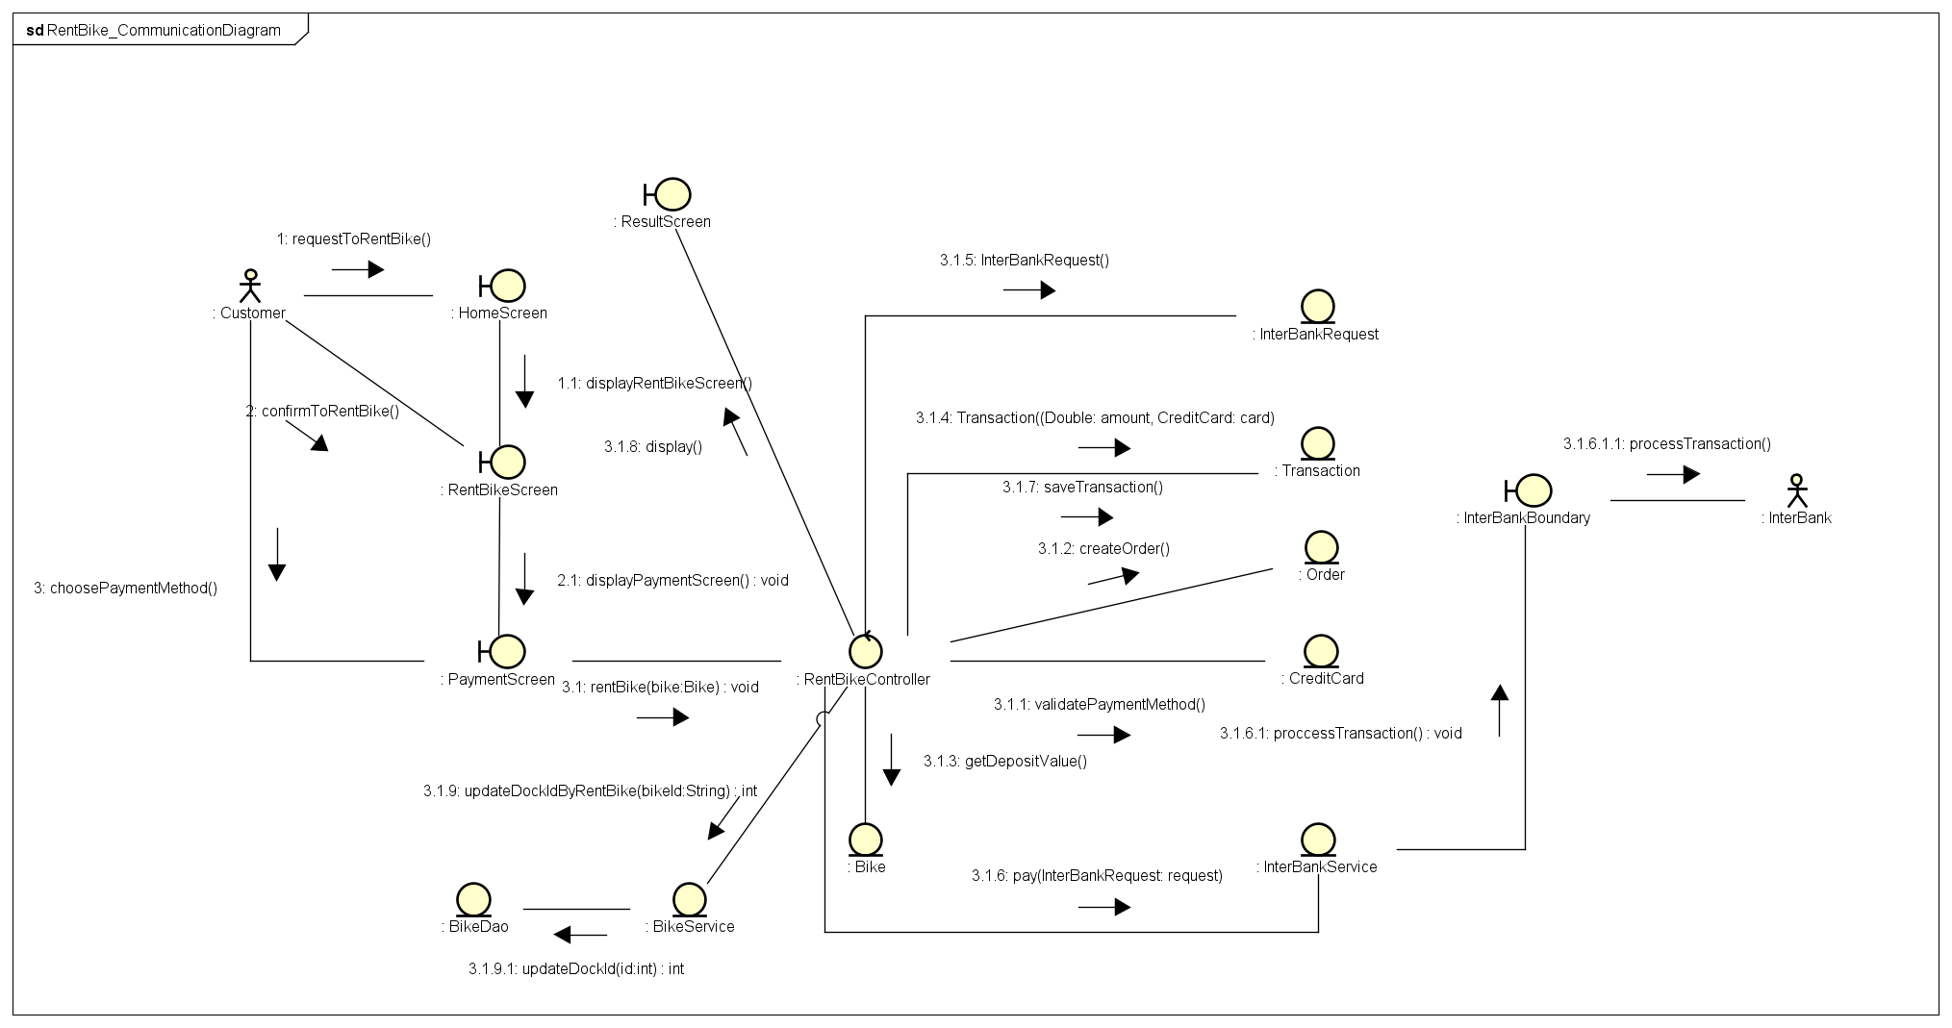
Interaction Diagram
Rent Bike Communication Diagram

Slide 5
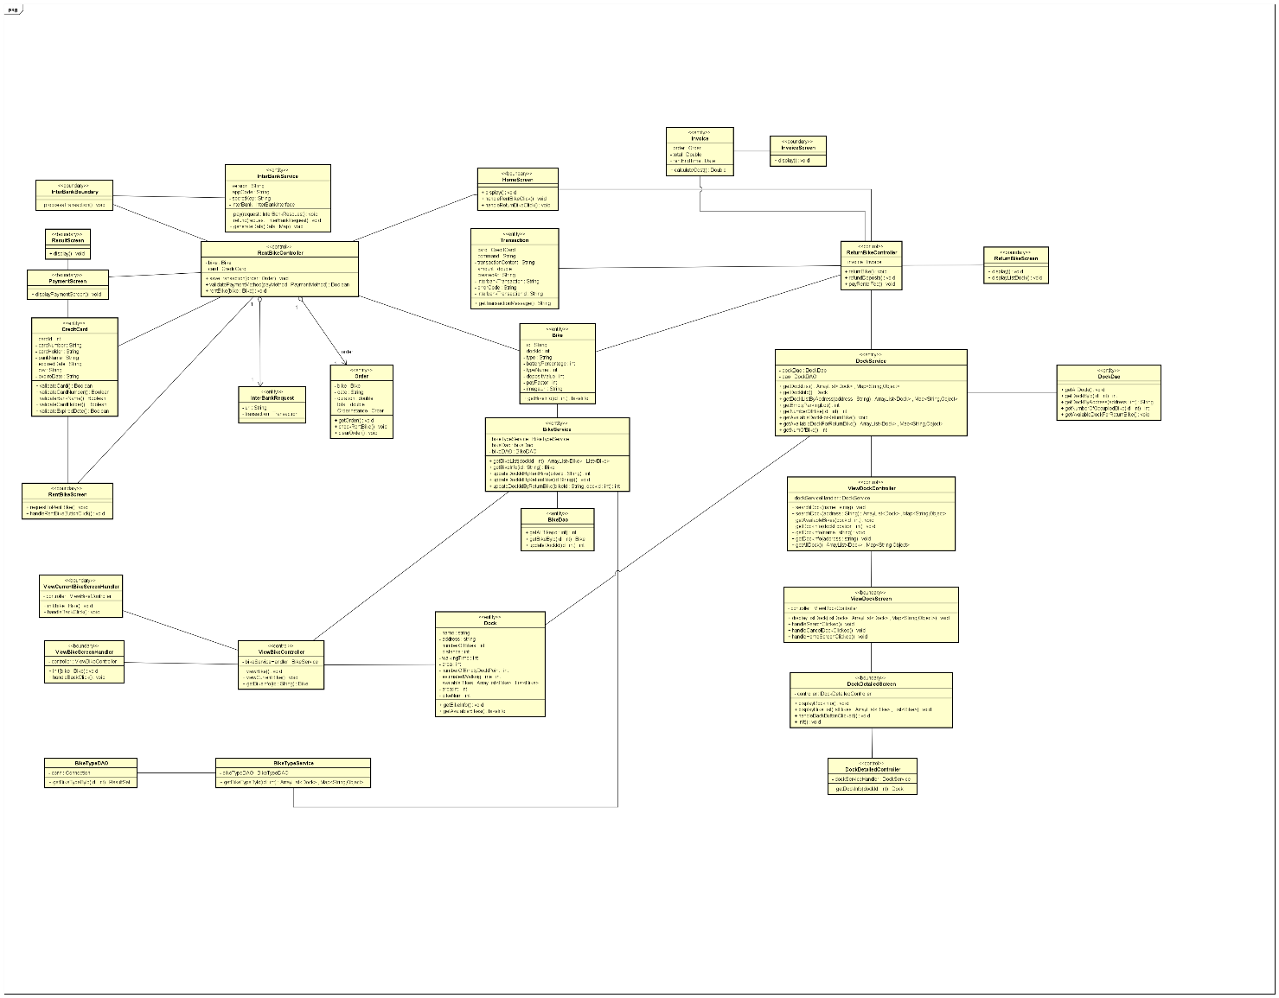
Class Diagram
Unified Class Diagram

Slide 6
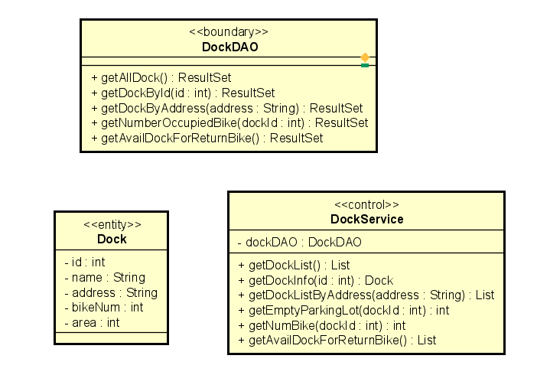
Class Diagram
Dock class diagrams

Slide 7
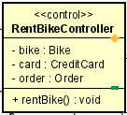
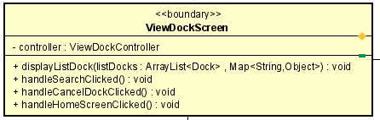
Class Diagram
RentBikeController Class Diagram
ViewDockScreen Class Diagram

Slide 8
Design Consideration
Design Concepts
Coupling
- InterbankBoundary implements InterbankInterface
- InterbankService interbankService = new InterbankService(new InterbankBoundary)
Cohesion
- 3 main package: model, controller, view
- Model: Entity(define Object), DAO, Service

Slide 9
Design Consideration
Design Principles
We create bikeType class and Bike Type information under database so if we create new bike, we can update database and not affecting the code

Slide 10
Design Consideration
Design Patterns
MVC Design Pattern
3 part: client to communicate with software, data in database, controller
➔ use MVC design pattern.
Singleton Design Pattern
Can be only 1 order exist so we use singleton design pattern
Data access object design pattern
The service remains completely in dark about how the low-level operations to access the database is done.

